Slide 1
ADV. JC WEAPOND EFFECTIVE RISK REPORTING – VALUE ADD REPORTING

Slide 2
Unconventional Partners

Slide 3
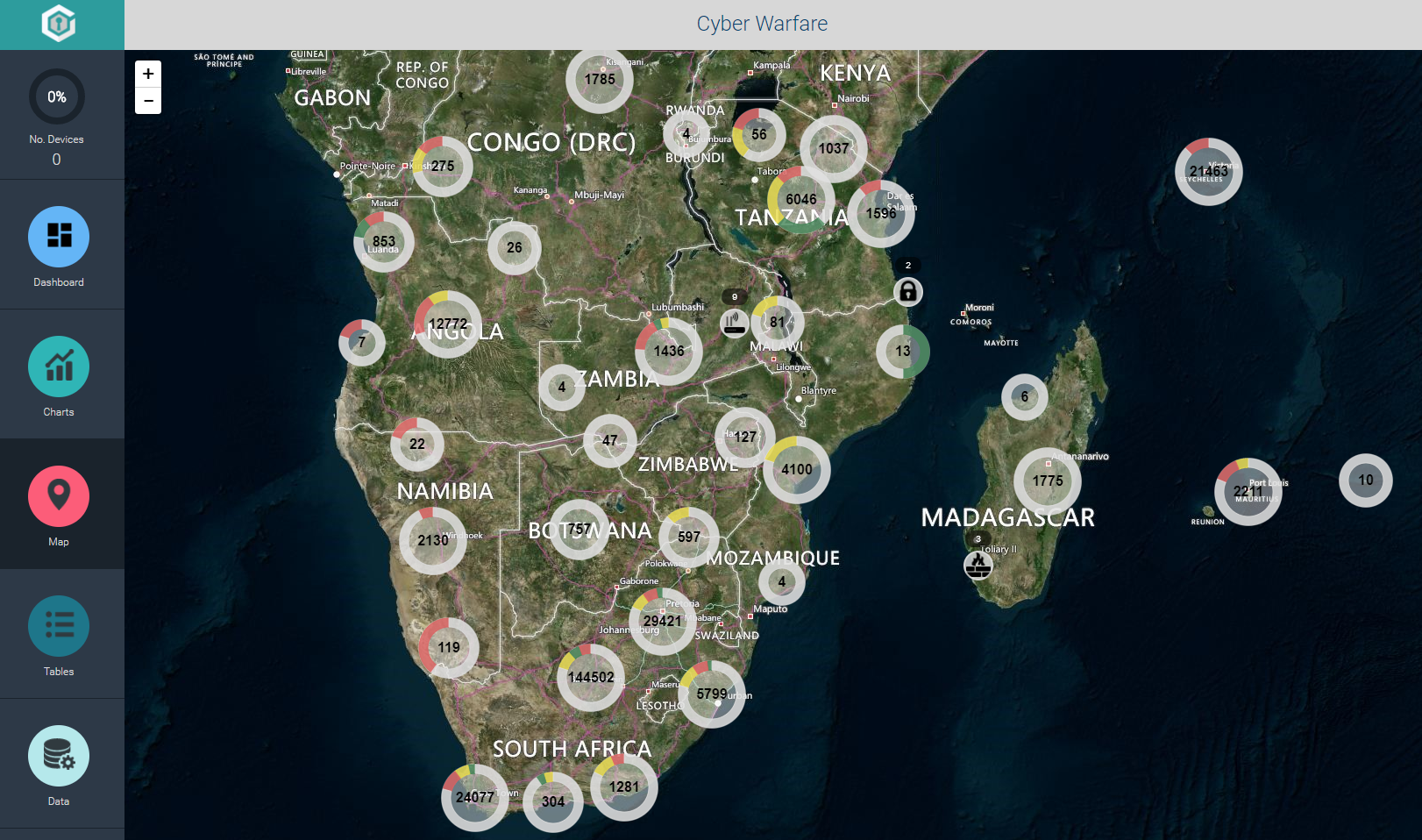

Slide 5
VALUE ADD REPORTING
GOLDEN RULES
Ensure root causes are properly identified
Ensure that each identified root cause has an action plan
Identify YOUR MAIN RISK
RISK – Tiger Brands
REPORT SEPARATELY on your MAIN RISK
Revisit impossible risks – Cape Town scenario
Make your report as practical as possible

Slide 6
VALUE ADD REPORTING
GOLDEN RULES
Disclaimer???????
Do you disclaim your report? Or
Have you covered all risks including the unforeseen???????
What's the purpose of a disclaimer
Do you disclaim your reports
Do you visit or inspect the main drivers of your business?

Slide 7
CONCLUSION
Certain interim risks were identified
Most of the deliverables are dependent on certain external approvals
Mitigations have been put in place.
Monitoring of risks and mitigations measures
END OF PRESENTATION!!!!!!!!!!!!!!!!!!!!!!!

